Slide 1
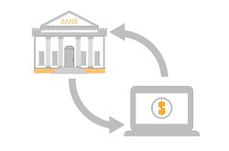
Predicting Term Deposit Subscriptions
This Photo by Unknown author is licensed under CC BY-NC.
DSC630: Predictive Analytics
Moshe Burnstein
Data originates in Portuguese banking institution

Slide 2
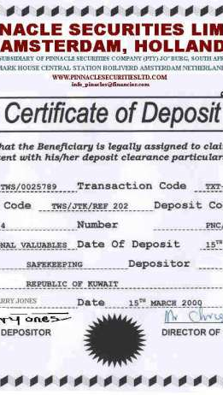
Term or Time Deposits
Guaranteed Interest Rate
Interest accrues until maturity date
Penalty for early withdrawal
When issued by banks, called certificates of deposit
When issued by credit unions. Called share certificates
This Photo by Unknown author is licensed under CC BY-SA.

Slide 3
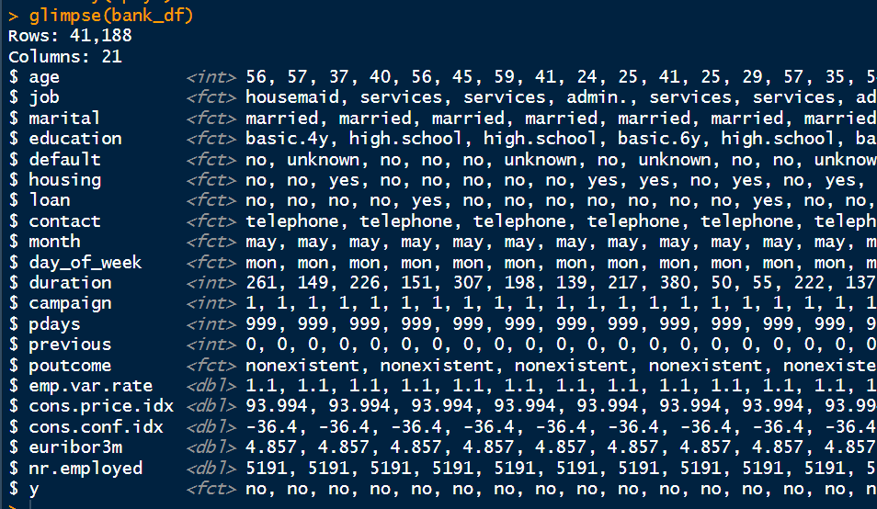
Glimpse at the Data collected between 2008 and 2010

Slide 4

Problem Statement
Too much time and money wasted on people who do not respond positively to marketing campaigns
Determine Which Feature or Mix of Features Drive Subscriptions
Create a Predictive Model
This Photo by Unknown author is licensed under CC BY-SA.

Slide 5
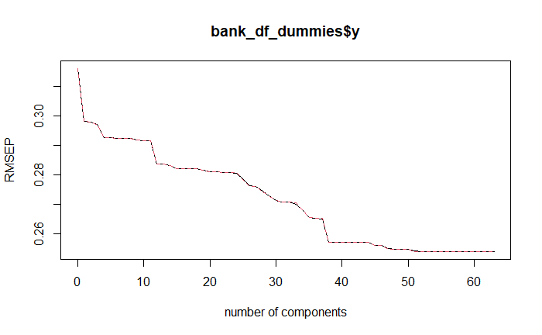
PCR Model- How Much Can We Reduce?

Slide 6
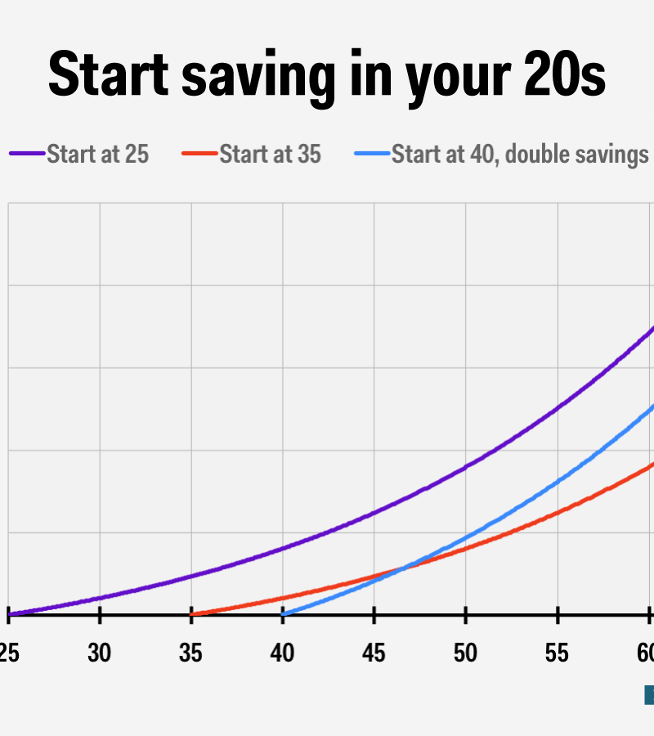

Save with Guaranteed Investments
Commonly assumed young and old populations tend to invest in safer fixed-rate investments.
This Photo by Unknown author is licensed under CC BY-SA.
This Photo by Unknown author is licensed under CC BY-NC-ND.

Slide 7

Accurately Target Potential Clients
Younger consumers do not have ongoing expenses and are not sophisticated enough to speculate
Older consumers need conservative investing
This Photo by Unknown author is licensed under CC BY-SA-NC.

Slide 8
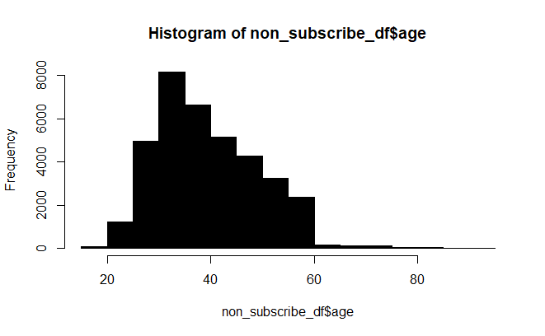
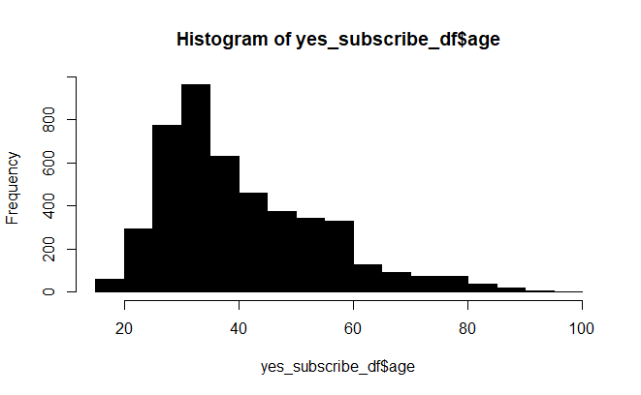
Distribution of Age
In less than 20 bin, yes-subscribe better represented
In all over 60 bins, yes-subscribe better represented

Slide 9
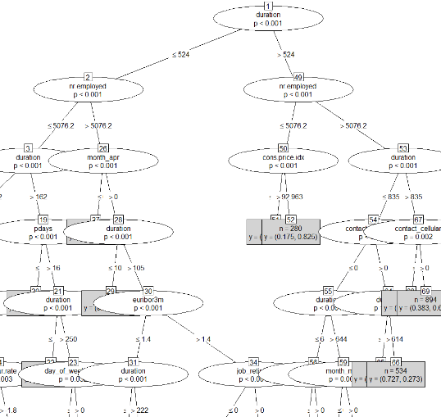
Random Forest Tree Leaf Nodes​​

Slide 10
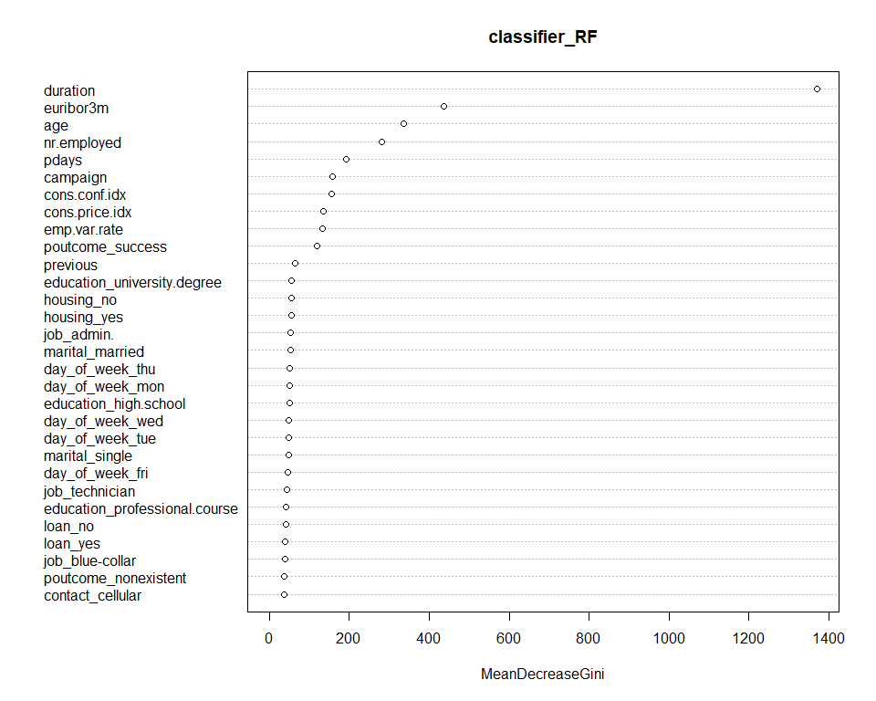
Most Important Features

Slide 11
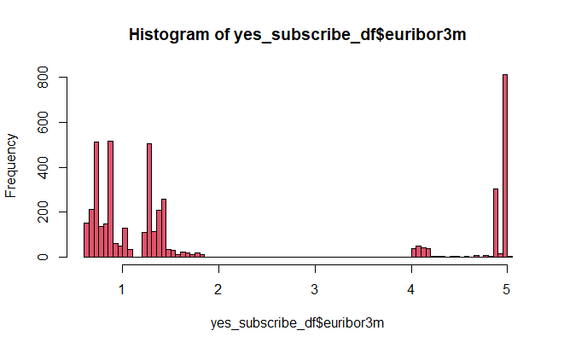
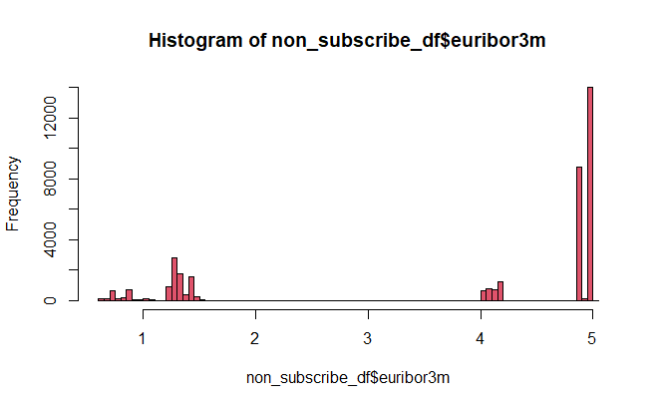
Euribor3m vs Subscription
Subset data into subscribers and non-subscribers. Subscribers occur with much greater frequency when rates are down.

Slide 12
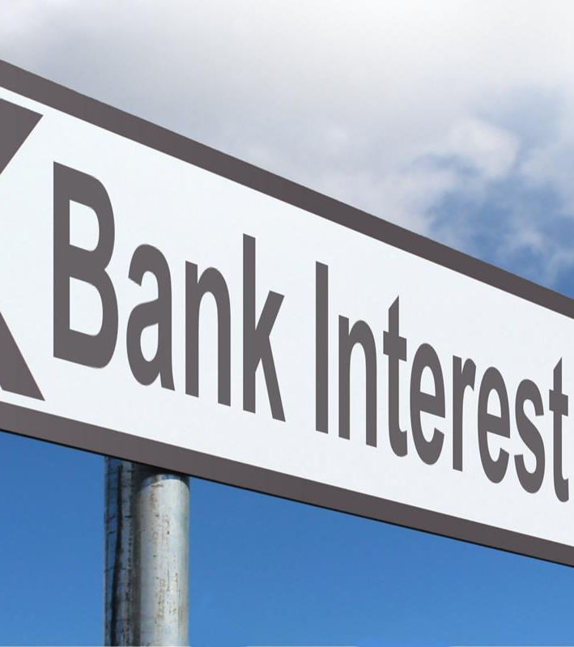
Invest in Term Deposits
When Banking Rates are Down​
When interest rates are down, consumers tend to invest in fixed-rate banking instruments. This protects their money from further rate reductions because one locks in his rate of return.​

Slide 13
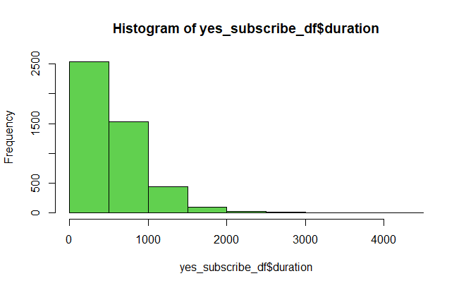
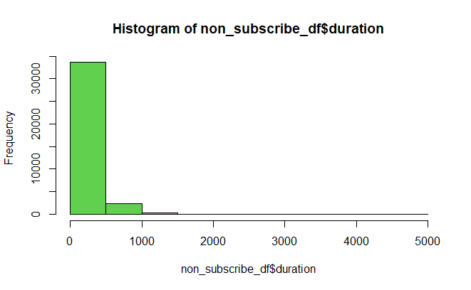

Duration of contact: Longer calls correlate with subscriptions​ ​

Slide 14
Goals of Modeling
Determine which form of campaigning will generate greatest profit​
Do not market to unlikely subscribers​
Increase profit by targeting potential subscribers with greatest likelihood to respond positively to marketing campaign​
Determine which classes of people best to reach out to ​

Slide 15


Models
Find most robust model. Pay special attention to specificity.
This Photo by Unknown author is licensed under CC BY-NC.

Slide 16
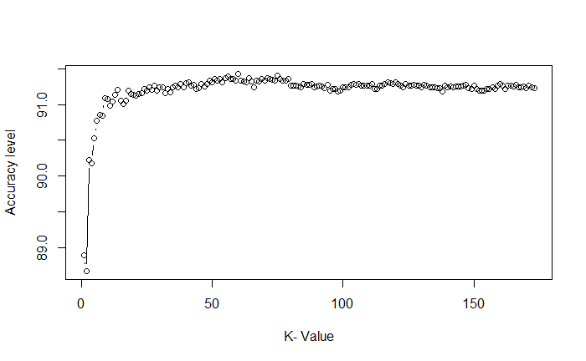
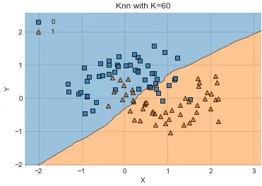
Choose best k

Slide 17
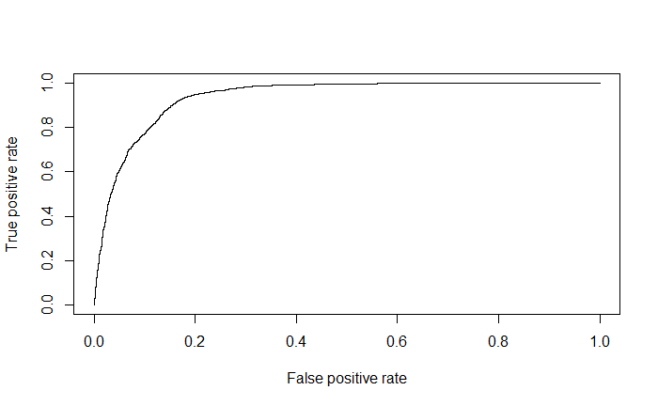
KNN Model Predicted almost half correctly
knn_60
1 2 1 11048 726 2 383 714 Accuracy : 0.9138 95% CI : (0.9089, 0.9186) No Information Rate : 0.8881 P-Value [Acc > NIR] : < 2.2e-16 Kappa : 0.516
Mcnemar's Test P-Value : < 2.2e-16
Sensitivity : 0.9665 Specificity : 0.4958 Pos Pred Value : 0.9383 Neg Pred Value : 0.6509 Prevalence : 0.8881 Detection Rate : 0.8584 Detection Prevalence : 0.9148 Balanced Accuracy : 0.7312 'Positive' Class : 1

Slide 18
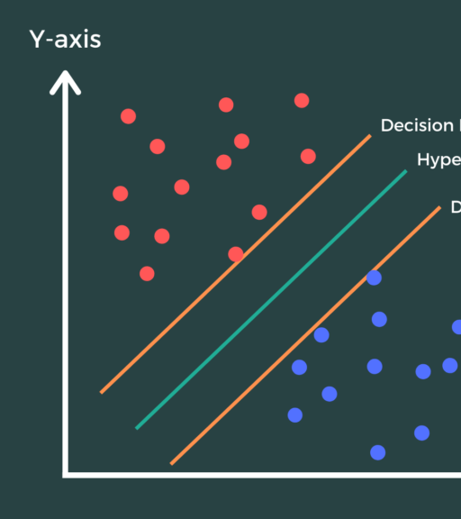
SVM Model with Hyperparameter Tuning
Confusion Matrix and Statistics Reference Prediction 1 2 1 11257 1081 2 149 387
Accuracy : 0.9045 95% CI : (0.8993, 0.9095) No Information Rate : 0.886
P-Value [Acc > NIR] : 7.465e-12 Kappa : 0.3464 Mcnemar's Test P-Value : < 2.2e-16 Sensitivity : 0.9869
Specificity : 0.2636 Pos Pred Value : 0.9124
Neg Pred Value : 0.7220 Prevalence : 0.8860
Detection Rate : 0.8744 Detection Prevalence : 0.9584
Balanced Accuracy : 0.6253 'Positive' Class : 1

Slide 19
Ensemble Models: Bagging and Boosting​
Bagged Model​
Confusion Matrix and Statistics​ ​ Reference​ Prediction 1 2​ 1 10973 700​ 2 433 768​ ​ Accuracy : 0.912 ​ 95% CI : (0.907, 0.9168)​ No Information Rate : 0.886 ​ P-Value [Acc > NIR] : < 2.2e-16 ​ ​ Kappa : 0.527 ​ ​ Mcnemar's Test P-Value : 2.733e-15 ​ Sensitivity : 0.9620 ​ Specificity : 0.5232 ​ Pos Pred Value : 0.9400 ​ Neg Pred Value : 0.6395 ​ Prevalence : 0.8860 ​ Detection Rate : 0.8523 ​ Detection Prevalence : 0.9067 ​ Balanced Accuracy : 0.7426 ​ ​ 'Positive' Class : 1
Xgboost Model​
Confusion Matrix and Statistics​ ​ Reference​ Prediction 1 2​ 1 11230 176​ 2 1020 448​ ​ Accuracy : 0.9071 ​ 95% CI : (0.902, 0.9121)​ No Information Rate : 0.9515 ​ P-Value [Acc > NIR] : 1 ​ ​ Kappa : 0.3866 ​ ​ Mcnemar's Test P-Value : <2e-16 ​ Sensitivity : 0.9167 ​ Specificity : 0.7179 ​ Pos Pred Value : 0.9846 ​ Neg Pred Value : 0.3052 ​ Prevalence : 0.9515 ​ Detection Rate : 0.8723 ​ Detection Prevalence : 0.8860 ​ Balanced Accuracy : 0.8173 ​ ​ 'Positive' Class : 1 ​

Slide 20
Important Model Scores
Model Name | Accuracy | Kappa | Sensitivity | Specificity | Balanced Accuracy
GLM using all features | 0.8335 | -0.0514 | 0.92121 | 0.03304 | 0.47713
Random Forest | 0.9115 | 0.4814 | 0.9737 | 0.4312 | 0.7024
kNN k=60 | 0.9138 | 0.516 | 0.9665 | 0.4958 | 0.7312
SVM with hyperparameter tuning | 0.9051 | 0.3746 | 0.9802 | 0.3066 | 0.6434
Ensemble Bagging | 0.9145 | 0.5441 | 0.9583 | 0.5613 | 0.7598
XGBoost | 0.9084 | 0.3932 | 0.921 | 0.6796 | 0.8003

Slide 21

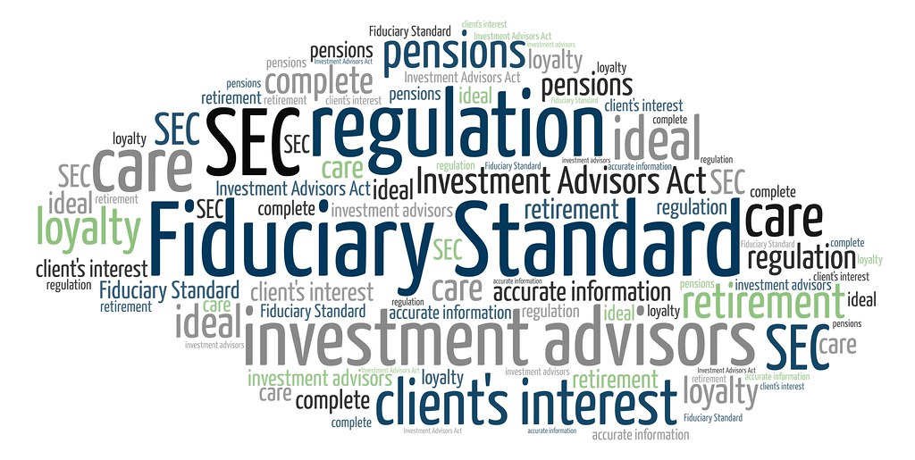
Ethical Implications
Data open-source and anonymous
Bank has fiduciary responsibility
This Photo by Unknown author is licensed under CC BY-SA-NC.
This Photo by Unknown author is licensed under CC BY.

Slide 22
Conclusions & Recommendations
Lower euribor3m rates are correlated with subscriptions. Banks should aggressively market term deposits when interest rates are down.
Young/Old age indicate more subscription-needs investigation
Duration of contact associated with subscriptions-needs investigation
Must secure more data- look for open-source available data. If unavailable invest in data collection for age and duration. If invest in your own survey, can test different hypotheses
The xgBoost Model ready to deploy

Slide 23
References
Aporras. (2020, November 3). What is the difference between bagging and boosting? ⋆ Quantdare. Quantdare. https://quantdare.com/what-is-the-difference-between-bagging-and-boosting/
Bennett, R. (n.d.). Term deposit vs. call deposit. Bankrate. Retrieved March 21, 2023, from https://www.bankrate.com/banking/term-deposit-vs-call-deposit/#term
Moro, S., Cortez, P., & Rita, P. (2014, June). A Data-Driven Approach to Predict the Success of Bank Telemarketing. UCI Machine Learning Repository: Bank Marketing Data Set. Retrieved March 21, 2023, from https://archive.ics.uci.edu/ml/datasets/Bank+Marketing
Improving your model. R. (n.d.). https://campus.datacamp.com/courses/introduction-to-machine-learning-in-r/how-much-will-i-earn?ex=6
Siegel, E. (2013). Predictive analytics: The power to predict who will click, buy, lie or die. John Wiley and Sons. Pages 213-217
What does your bank do with your money? ThinkBank. (n.d.). Retrieved April 19, 2023, from https://www.tmbank.com.au/thinkbank/industry-news/what-does-your-bank-do-with-yourmoney
What is the K-nearest neighbors algorithm?. IBM. (n.d.-a). https://www.ibm.com/topics/knn

